Slide 1
Paper Chromatography

Slide 2
Topics to be covered
Qualitative and quantitative estimation by chromatography.
Definition, types (paper, gas and liquid) and application of Chromatography.
Solvents; petroleum ether (Non- polar) ,acetone (nonpolar) and water (Polar) their role in paper chromatography.
Ratio of a mixture= 3:1:1
Mobile phase :- Liquid/Gas (Petroleum ether and Acetone)
Stationary Phase:-Solid or a liquid supported on a solid (Whatman paper and water)
Distribution coefficient(Kd) Concentration in solvent A(mobile phase)
Concentration in stationary phase
Retention factor(Rf) Distance travelled by substance
Distance travelled by solvent
Significance of Distribution coefficient and retention factor as mentioned below
a) Polarity of compound
b) solubility of compound in solvent

Slide 3
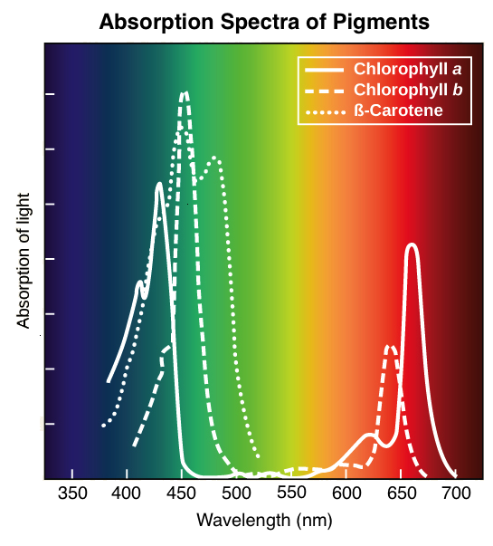
What are polyenes compounds?
Absorption wavelength range of pigments as
mentioned below: Fig1
Chl a: 400-450 nm lambda max. – 425 nm
Chl b: 450 - 500 nm lambda max. – 450 nm
Caretoinoids:450 – 500nm lambda max. – 450 nm
Fig-1- Absorption Spectra of pigments

Slide 4
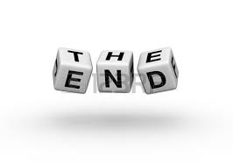
Types of Chlorophyll :(a, b,c,d,e).
Primary photosynthetic pigment (chlorophyll a).
Accessory pigments ( Chl b,c, d, e, xanthophylls carotenoids)
Distribution of Pigments as mentioned below:
Chl a and chl b: Plants
Chl c,d,e along with chl a: Algae
Chl b is absent in bluegreen algae and red algae
Structure of chlorophyll:
Tadpole like structure
Porphyrin head and Phytol tail structure.
Characteristic side groups of chl a and chl b
Colour of pigments.

